Slide 1
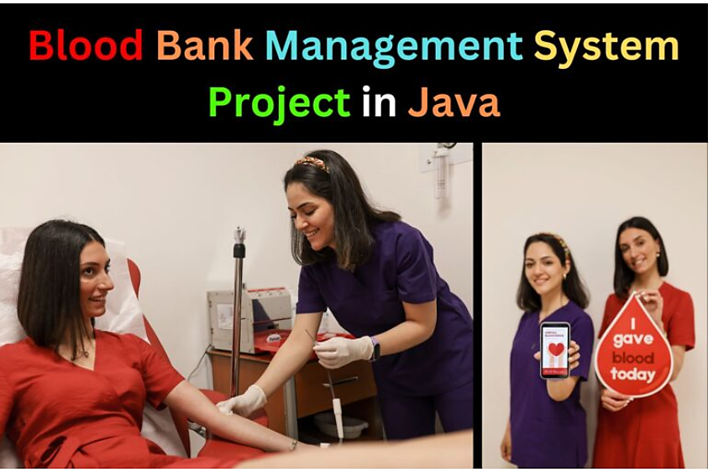
Blood Bank Management System
Presented By :-
1. Ayush (23SCSE1290037)
2. Tanu gangwar (23SCSE1260003)
3. Chandan kumar (23SCSE1290015)

Slide 2
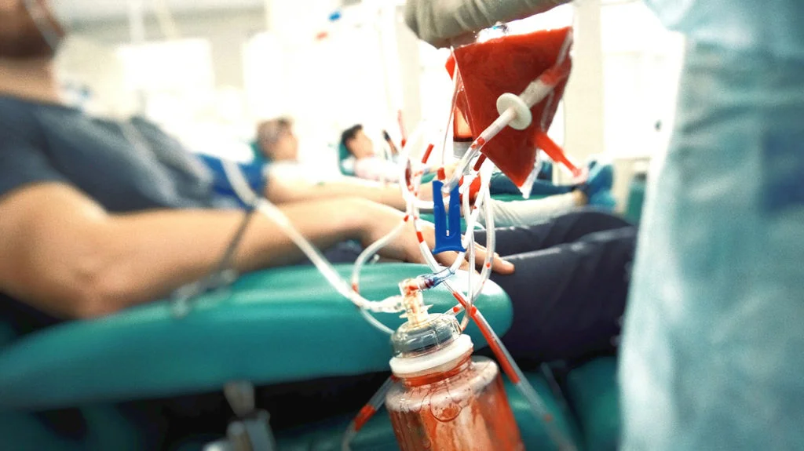
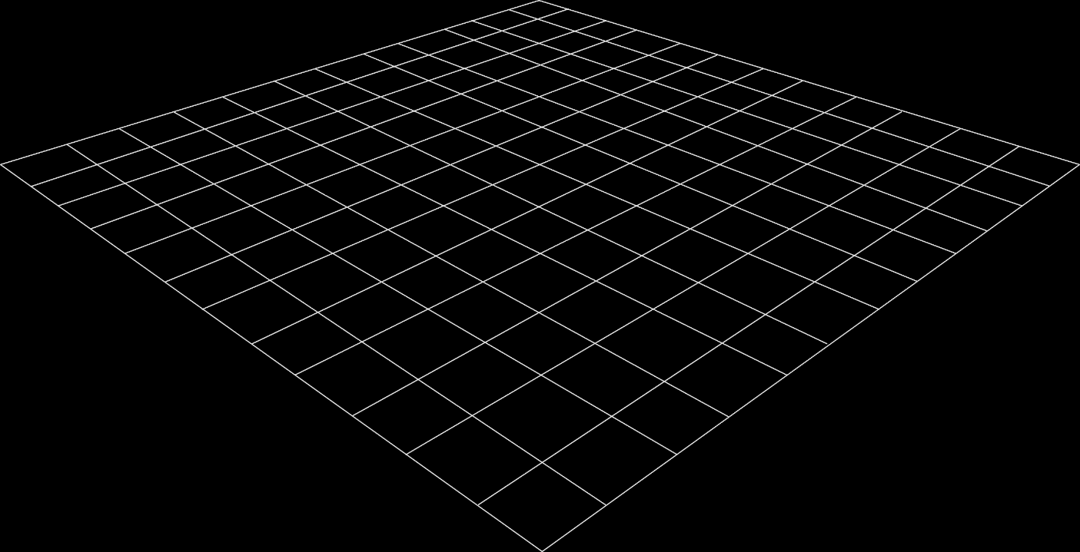
Introduction
Importance of Blood Donation:
Every two seconds, someone needs blood.
One donation can save up to three lives.
Problem Statement:
Many people don’t know how to donate blood.
It’s hard to connect donors with people who need blood.

Slide 3
Objectives
Connect Donors & Recipients:
Create a simple platform for people to find each other.
Search Feature: Let users find specific blood types nearby.
2. Raise Awareness:
Provide easy-to-read articles and videos about blood donation.
Community Events: Tell people about upcoming donation drives.
3. Streamline the Process:
Easy Registration: A simple step-by-step guide for signing up.
Allow users to quickly request and track blood donations.
Feedback: Ask users for their thoughts to make things better.
4. Enhance User Experience:
Design a friendly interface for both mobile and computer users.
Personal Dashboards: Help users track their donations and requests easily.

Slide 4
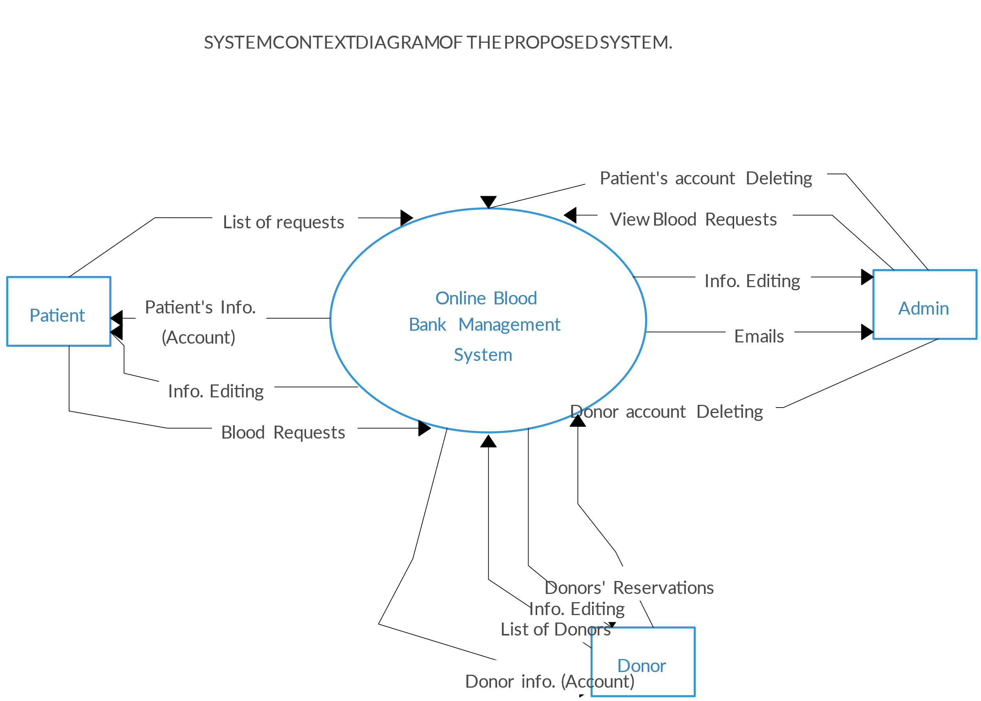
System Architecture
Components Overview:
User Interface (UI): User-friendly design for easy navigation.
Database Management: Secure storage of donor and donation data.
Backend Logic: Robust processing using Java.
Technologies Used:
Java, IntelliJ IDEA, MySQL (or preferred database).

Slide 5
Implementation
Technical Approach:
Java: Core logic for processing requests.
JDBC: Connecting Java application to the MySQL database.
Data Validation: Ensuring user inputs are secure and correct.
Error Handling: Strategies to manage potential issues smoothly.

Slide 6
Conclusion
1
Summary:
Blood donation is vital for healthcare.
Our system addresses the need for better connectivity and awareness.
Call to Action: Encourage everyone to participate in blood donation drives.
Impact:
By using this platform, we hope to increase participation in blood donation drives.
The system not only helps those in need but also builds a community of donors who can support each other.

Slide 7


